Slide 1
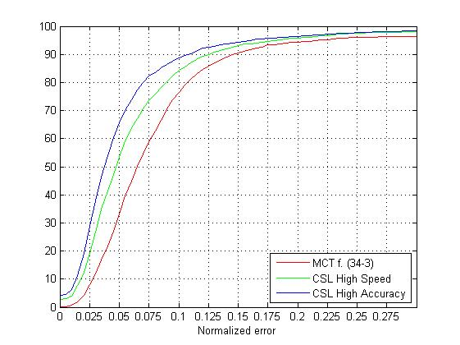
Eye Detection
눈 검출율 (normalized error:0.05 / 0.10 / 0.15) 검출속도
기존 삼성 검출기 : 33.3% /76.4% /90.6%
개발 검출기 (CSL_High Speed) : 53.4% /84.2% /93.1% 9~14 ms
개발 검출기 (CSL_High Accuracy) : 65.7% /88.8% /94.4% 17~23 ms

Slide 2
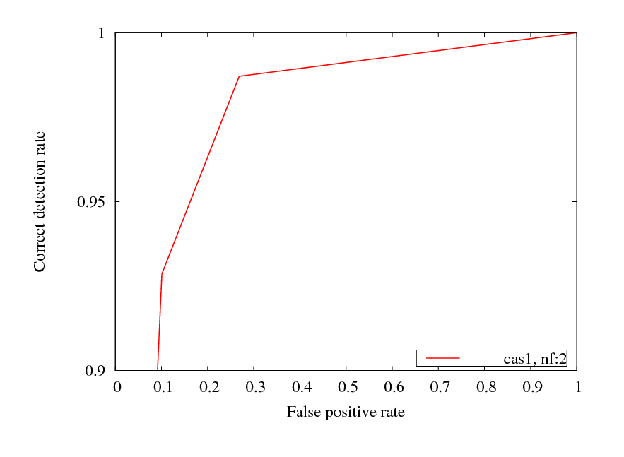
Stage 1 <ft: 2>

Slide 3
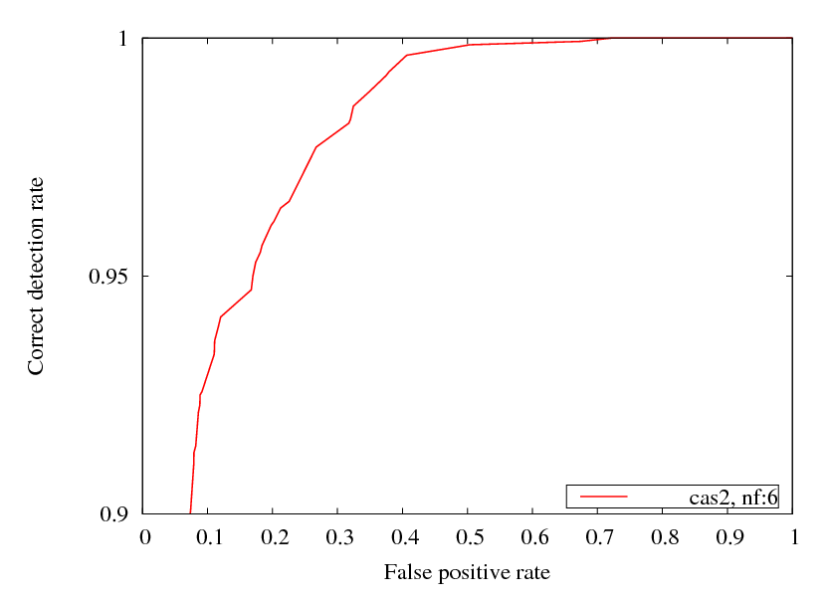
Stage 2 <ft: 6>

Slide 4
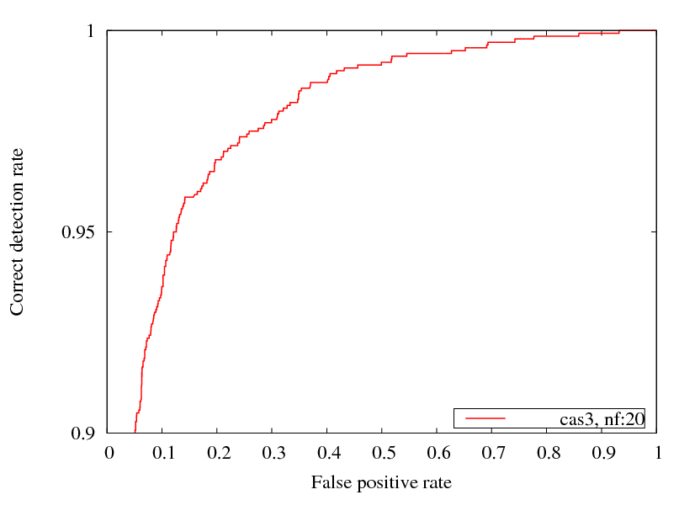
Stage 3 <ft: 20>

Slide 5
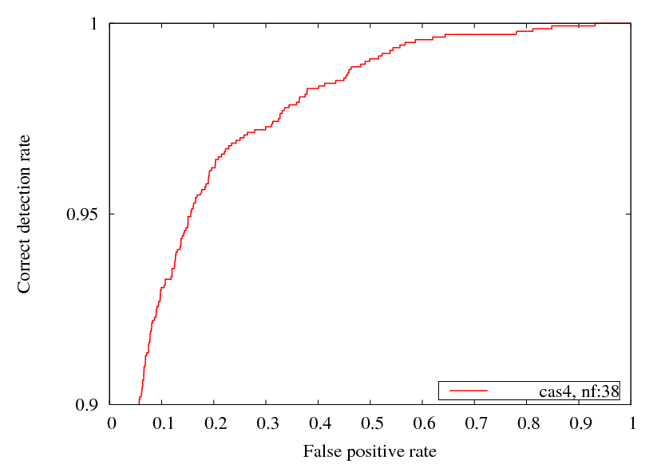
Stage 4 <ft: 38>

Slide 6
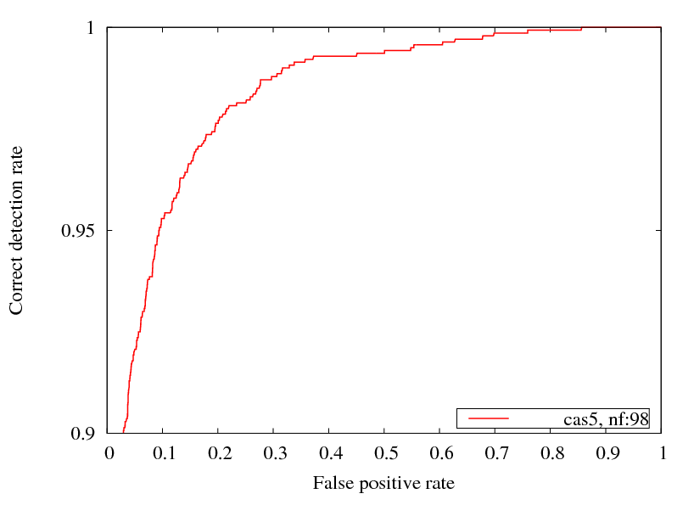
Stage 5 <ft: 98>

Slide 7
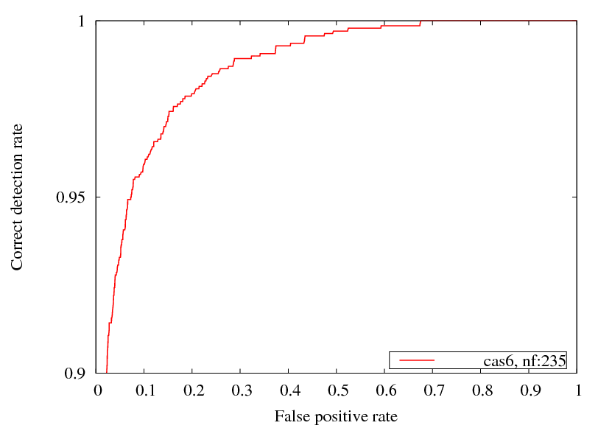
Stage 6 <ft: 235>

